Slide 1
Module 3: Running Experiments and Training Models
Notes:
Like any scientific discipline, data science involves running experiments; typically to explore data or to build and evaluate predictive models. In Azure Machine Learning, an experiment is a named process, usually the running of a script or a pipeline, that can generate metrics and outputs and be tracked in the Azure Machine Learning workspace.

Slide 2


Agenda
Introduction to Experiments
Training and Registering Models
Notes:
In this module, we'll introduce experiments and how to use the Python SDK to run them, and then we'll focus specifically on how to use experiments to train machine learning models.

Slide 3
Introduction to Experiments
Notes:
Let's start by exploring experiments, and how to run them using the Azure Machine Learning Python SDK.

Slide 4
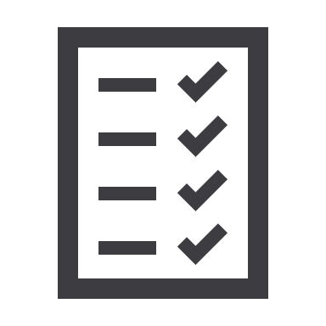

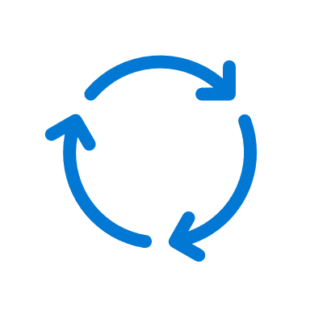
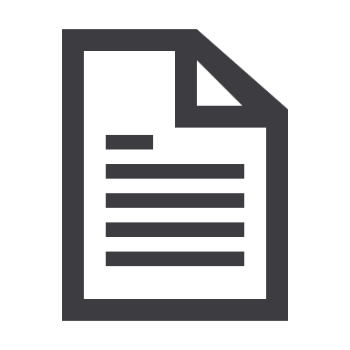



What is an Experiment?
An executable process that is run one or more times – often a script
Each run generates metrics and output files
Metadata and events are recorded in log files
Notes:
In Azure Machine Learning, experiments are named executable processes (usually based on scripts) that can be run one or more time. Each experiment run generates metrics and outputs that are recorded for future review. Additionally, metadata for the experiment run, and events that occur during the run are logged. The logged metadata includes the context for the experiment – for example, if the experiment is based on a script that is stored in a GitHub repo, metadata about the GitHub branch is included in the logged metadata.

Slide 5
Running an Experiment Inline
Create (or get existing) experiment in workspace
from azureml.core import Workspace, Experiment
import pandas as pd
ws = Workspace.from_config()
experiment = Experiment(workspace=ws, name='my-experiment')
run = experiment.start_logging()
data = pd.read_csv('data.csv')
row_count = (len(data))
run.log('observations', row_count)
data.sample(100).to_csv('sample.csv', index=False, header=True)
run.upload_file(name='outputs/sample.csv', path_or_stream='./sample.csv')
run.complete()
Start experiment run
Log metrics in run
Save or upload output files
Complete the run
Notes:
You can use the Python SDK to run an Azure Machine Learning experiment inline, for example in a notebook. The key steps you need to perform in your code are:
1. Create or retrieve a named experiment in your workspace.
2. Start a run of the experiment – retrieving an active Run object.
3. Use the Run object to log metrics you want to review later.
4. Save or upload files to the run's outputs folder so that they are stored in the run history.
5. Complete the run
After completing the run, you can view its logs, metrics and outputs in Azure Machine Learning studio or use the SDK to retrieve them programmatically. There's also a widget that you can use to display run details in a notebook.

Slide 6
Running a Script as an Experiment
Script:
Control code (to initiate and monitor experiment run):
Get the experiment run context for the current script
from azureml.core import Run
run = Run.get_context()
run.log(…)
run.complete()
from azureml.core import Workspace, Experiment, ScriptRunConfig
ws = Workspace.from_config()
script_config = ScriptRunConfig(source_directory='my_dir',
script='script.py')
experiment = Experiment(workspace=ws, name='my-script-experiment')
run = experiment.submit(config=script_config)
Define run settings for the experiment script
(can include compute target, conda environment, and more)
Notes:
In most scenarios, the code for your experiment is encapsulated in a script file that can be run on local or remote compute. The script file contains the code necessary to retrieve the run context and log metrics and outputs.
To run the script as an experiment, you need a control layer to initiate it – this may be another script, code in a notebook, or even a CLI command in a DevOps pipeline. If you're using Python code to initiate a script-based experiment, you need to define a ScriptRunConfig object that encapsulates the run settings for the experiment, specifying the script to be run, and optionally the Python Conda environment in which to run it, and the compute target on which the environment should be hosted.

Slide 7
Using MLflow
Using MLflow Inline
Using MLflow with Scripts
Configure MLflow to log to the Azure Machine Learning workspace
from azureml.core import Experiment
import mlflow
mlflow.set_tracking_uri(ws.get_mlflow_tracking_uri())
experiment = Experiment(workspace=ws, name='mlflow-experiment')
mlflow.set_experiment(experiment.name)
with mlflow.start_run():
mlflow.log_metric('my_metric', 123)
Create an experiment in the workspace
Create and start an MLflow run of the Azure ML experiment
Script:
Control code:
import mlflow
with mlflow.start_run():
mlflow.log_metric('my_metric', 123)
sc = ScriptRunConfig(source_directory='my_dir',
script='script.py',
environment=env)
ex = Experiment(workspace=ws, name='mlf-exp')
run = ex.submit(config=sc)
An Environment that includes the mlflow package
Tracking URI is set to workspace automatically
Notes:
MLflow is an Open Source library for managing machine learning experiments, and includes tracking functionality for logging metrics. It's commonly used in Databricks and other machine learning platforms to implement logging and model management. If your organization already uses MLflow, you can continue to use it to track metrics in Azure Machine Learning for both inline and script-based experiment runs.
Note: We'll discuss environments in more depth later – for now, just be aware that to use MLflow in a script-based experiment, you need to define an environment that includes the mlflow Python package.

Slide 8

Lab: Run Experiments
View the lab instructions at https://aka.ms/mslearn-dp100
Complete the Run experiments exercise
Notes:
Students can complete the lab using only a browser and the Azure subscription they created previously. The lab instructions are at the address on the slide.
Alternatively, if students are using a hosted environment to complete the lab, get them to start it and find ther appropriate exercise instructions..

Slide 9
Training and Registering Models
Notes:
While you may want to run experiments that extract and log insights from data, the most common task data scientists and machine learning engineers want to accomplish using Azure Machine Learning is to train machine learning models; so let's look at what's involved in doing that.

Slide 10
Training a Model in a Script
Script:
Control code:
from azureml.core import Run
import joblib
from sklearn.linear_model import LogisticRegression
...
joblib.dump(value=model, filename='outputs/model.pkl')
Save trained model in outputs folder to record is in experiment run
from azureml.core import Workspace, Experiment, ScriptRunConfig,
Environment, CondaDependencies
env = Environment('training_env')
deps = CondaDependencies.create(pip_packages=['scikit-learn','azureml-defaults'])
env.python.conda_dependencies = deps
script_config = ScriptRunConfig(source_directory='my_dir',
script='script.py',
environment=env)
experiment = Experiment(workspace=ws, name='my-script-experiment')
run = experiment.submit(config=script_config)
Run script in an environment that includes required ML framework
Scikit-Learn, PyTorch, TensorFlow, …
Notes:
You can use a Script Run Configuration to run a script-based experiment that trains a machine learning model using common machine learning frameworks like Scikit-Learn, PyTorch, or TensorFlow.
A training script is just like any other experiment script – you'll commonly use the Run object to log metrics as you train the model for example. Typically, after training the model, the script saves it (in whatever format is appropriate for the framework used to train it) in the outputs folder for the run, so it can be retrieved later. For example, when using Scikit-Learn. you might save the trained model as a .pkl file.
To run the training script, the control code used to initiate the experiment must specify a run environment that includes the required machine learning framework (and any other required packages). The environment should also include the azureml-defaults package (which includes a subset of the SDK to support access to the Workspace and Run objects among other things)
Note: If you don't specify an environment, a default one containing azureml-defaults is used automatically – however, this may not include the machine learning framework package your script needs. We'll explore environments in a bit more detail later in the course!

Slide 11
Using Script Arguments
Script
Control code:
Parse script arguments
import argparse
parser = argparse.ArgumentParser()
parser.add_argument('--reg_rate', type=float, dest='reg_rate', default=0.01)
args = parser.parse_args()
model = LogisticRegression(C=1/args.reg_rate).fit(X_train, y_train)
Use argument values in script
script_config = ScriptRunConfig(source_directory='my_dir',
script='script.py',
arguments = ['--reg_rate', 0.1],
environment=env)
Specify named arguments in ScriptRunConfig
Notes:
You can increase the flexibility of script-based experiments by using arguments to set variables in the script. This is commonly used to specify values for hyperparameters used by training algorithms.
To use parameters in a script, you must use a library such as argparse to read the arguments passed to the script and assign them to variables. For example, the script on the slide reads an argument named --reg-rate, which is used to set the regularization rate hyperparameter for the logistic regression algorithm used to train a model.
To pass argument values to a script being run in an experiment, you need to provide an arguments value containing a list of comma-separated argument name and value pairs to the ScriptRunConfig. as shown on the slide.

Slide 12
Registering a Model
Register from training run:
Register from local file(s)
Retrieve registered models
Model saved in run outputs
run.register_model(model_name='classification_model',
model_path='outputs/model.pkl',
description='A classification model')
from azureml.core import Model
model = Model.register(model_name='classification_model',
model_path='local_dir/model.pkl',
description='A classification model'
workspace = ws)
Local model (can be file or folder)
Models are automatically versioned based on name
for model in Model.list(ws):
print(model.name, 'version:', model.version)
Notes:
Model registration enables you to track multiple versions of a model, and retrieve models for inferencing (predicting label values from new data). When you register a model, you can specify a name, description, tags, framework (such as Scikit-Learn or PyTorch), framework version, custom properties, and other useful metadata.
After running a training experiment, you can use the reference to the Run object's register_model method to register a model that was saved in the run's outputs folder.
Alternatively, you can use a reference to a Run object to download its outputs, including trained model files, and then register a model from the local files by using the register method of the Model object. You can also use this method to register models that were trained outside of an Azure Machine Learning experiment.
Registering a model with the same name as an existing model automatically creates a new version of the model, starting with 1 and increasing in units of 1.

Slide 13
Lab: Train Models
View the lab instructions at https://aka.ms/mslearn-dp100
Complete the Train models exercise
Notes:
Students can complete the lab using only a browser and the Azure subscription they created previously. The lab instructions are at the address on the slide.
Alternatively, if students are using a hosted environment to complete the lab, get them to start it and find ther appropriate exercise instructions..

Slide 14

Knowledge check
You are using the Azure Machine Learning Python SDK to write code for an experiment. You must log metrics from each run of the experiment and be able to retrieve them easily from each run.
What should you do?
Add print statements to the experiment code to print the metrics.
Use the log* methods of the Run class to record named metrics
Save the experiment data in the outputs folder
You want to use a script-based experiment to train a PyTorch model, setting the batch size and learning rate hyperparameters to different values each time the experiment runs.
What should you do?
Create multiple script files – one for each batch size and learning rate combination you want to use.
Set the batch_size and learning_rate properties of the ScriptRunConfig before running the experiment.
Add arguments for batch size and learning rate to the script, and set them in the arguments property of the ScriptRunConfig
Notes:
Use the slide animations to reveal the correct answers.

Slide 15
References
Microsoft Learn: Introduction to Azure Machine Learning
https://docs.microsoft.com/learn/modules/intro-to-azure-machine-learning-service
Microsoft Learn: Train a machine learning model with Azure Machine Learning
https://docs.microsoft.com/learn/modules/train-local-model-with-azure-mls
Azure Machine Learning training run documentation
https://docs.microsoft.com/azure/machine-learning/how-to-set-up-training-targets
Notes:
Use the references on the slide to learn more. In particular, note the online learning modules on Microsoft Learn that are related to the material covered in this module.

Slide 16
Closing slide

